Slide 1
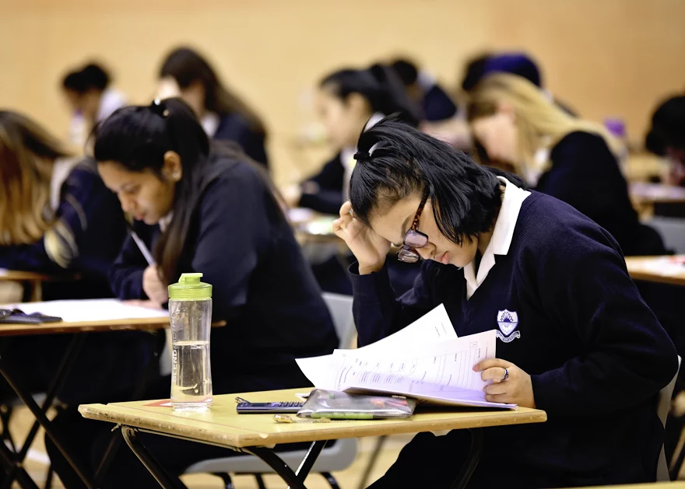

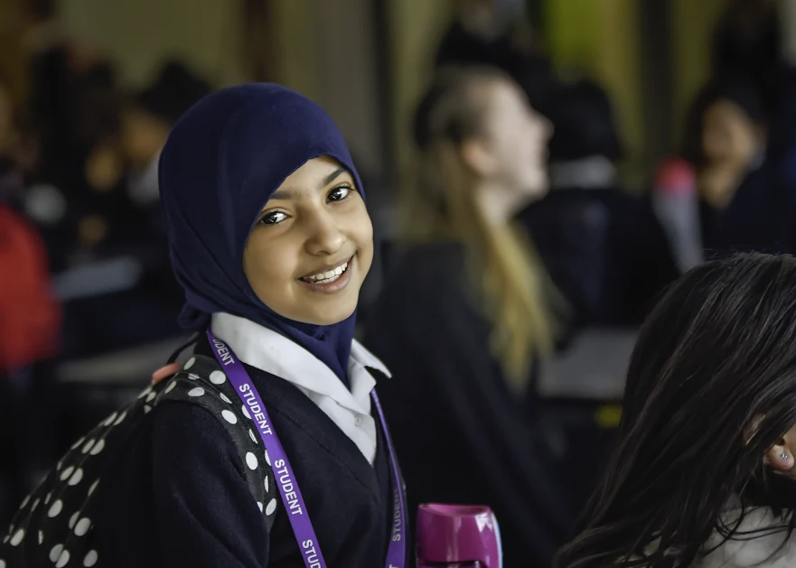
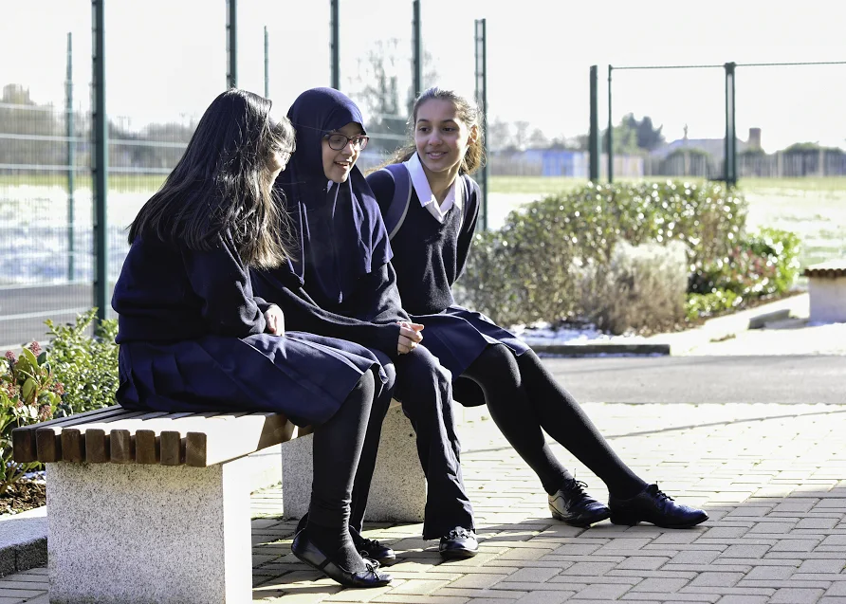
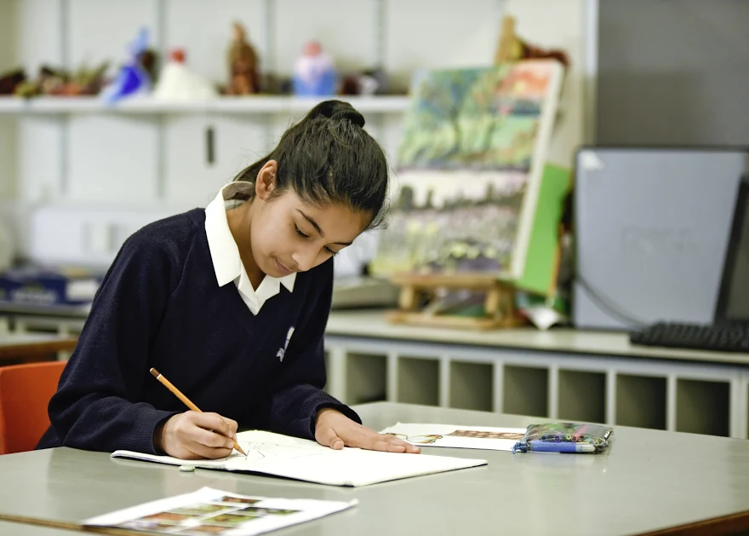
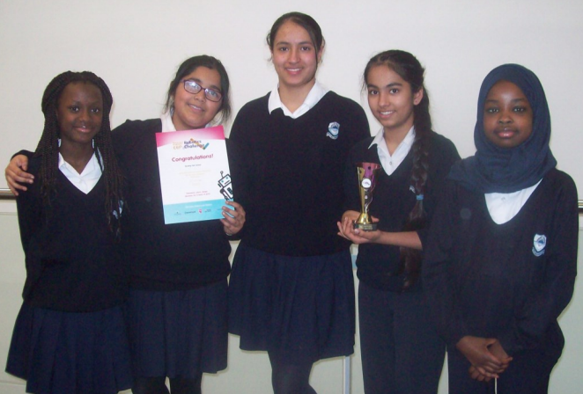
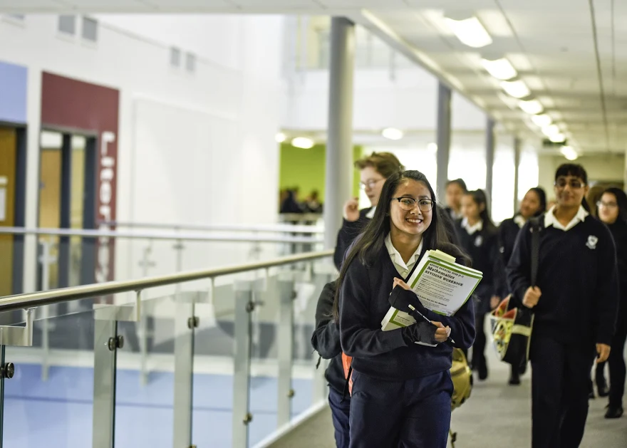
Welcome to RGS
Year 7 September 2025

Slide 2

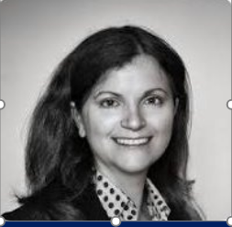
Welcome from the Principal
Top performing non selective school in Reading
Attainment is significantly above national average
Progress is significantly above national average
Attendance is significantly above national average
95% of pupils "behaviour is good"
97% "I feel safe at school"

Slide 3
Our vision
At Reading Girls’ School, we aim to empower every young woman to thrive by fostering a culture of excellence, kindness and respect.
We are committed to providing a broad and balanced curriculum that nurtures students' academic, social, and emotional development, instilling in them a spirit of curiosity, resilience, and global citizenship.
The curriculum is inclusive, ambitious and designed to meet the needs of every individual student.
Our aim is to create a supportive and inclusive environment enabling them to reach their full potential and become independent, brave, and compassionate individuals.

Slide 4
Our Values
Kindness and Respect
Empowerment
Excellence
We are a school where every child is able to:
Explore, Question & Grow, with a spirit of curiosity
Be happy and flourish
Be a life longer learner, who are independent, brave, and encouraged to take risks.
Contribute to the community, whether it is in school, in their local areas or in the world.
'Happy and successful'

Slide 5
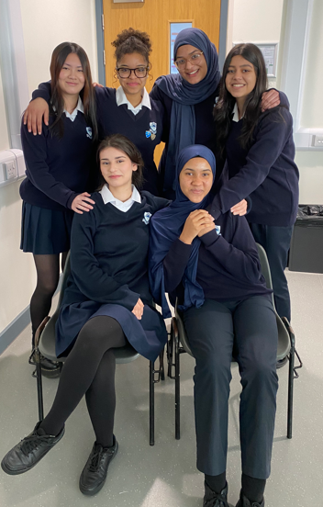
Head Girls
Maimuna Humphreys
Lua Selas
“Staff and pupils value how much they can learn from their diverse school community. They respect each other’s views and nurture everyone’s differences”
Reading Youth Council Representatives

Slide 6
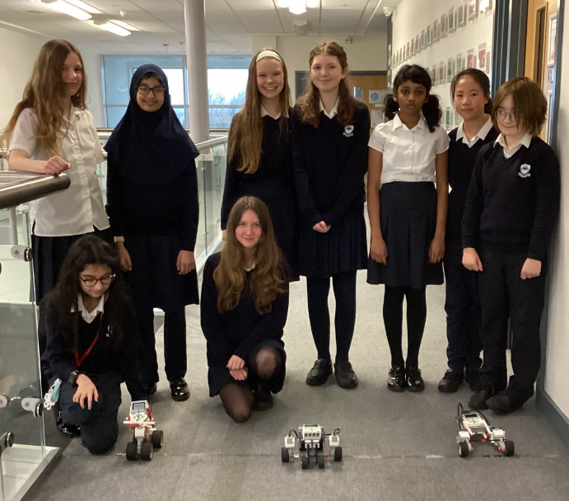
Curriculum
In Years 7 and 8, your daughter will explore a variety of subjects to help her discover interests and talents.
We offer a wide range of subjects so they can experience different fields of study. This helps make informed choices when it's time to pick their GCSE subjects options late in Year 8.

Slide 7
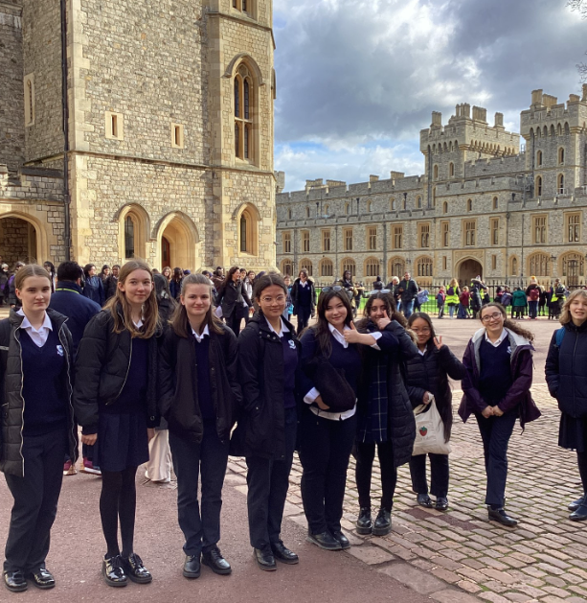
Curriculum
At the end of Year 8, they will have the exciting opportunity to choose the subjects they want to focus on for the GCSE exams.
Our goal is to provide a well-rounded education that prepares every student for success in the future.
With our support, every student will have the freedom to explore their passions and build a pathway to achieve their goals

Slide 8
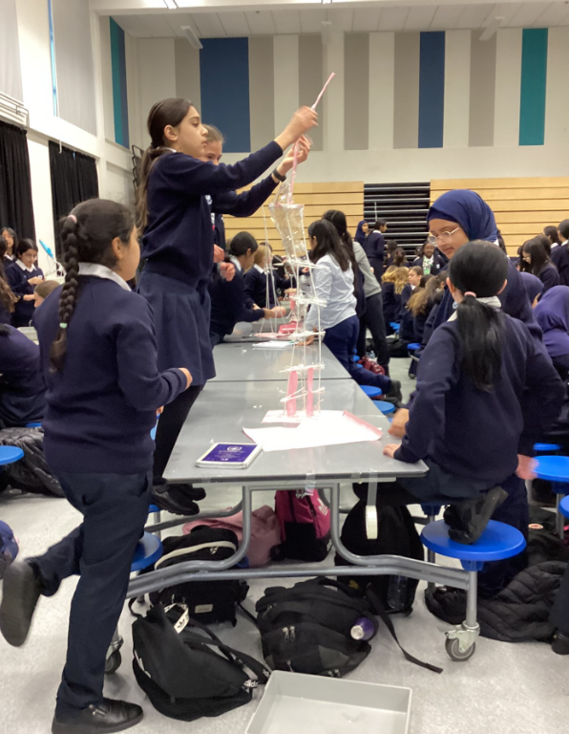
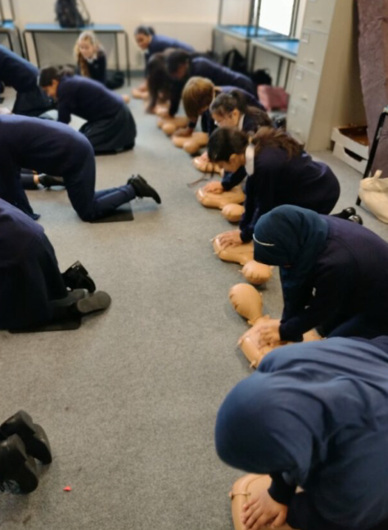
Wider curriculum
“Students are provided with many opportunities for Personal Development. This includes interesting workshops, external speakers, and different school clubs and trips”

Slide 9
Last half term students were involved in many activities:
After school clubs
Visits to Reading University
Year 10 Reading University Scholarship Programme
Trip to Windsor Castle/Tower of London/London Theater
Year 7 Immersive workshop run by Reading University on Victorian Transport.
Aspire 2 Public Speaking Competition
Trip to Berlin 2025
Year 9 PSHE play by the UpFront Theatre Company.
Year 10 Personal Development Day

Slide 10
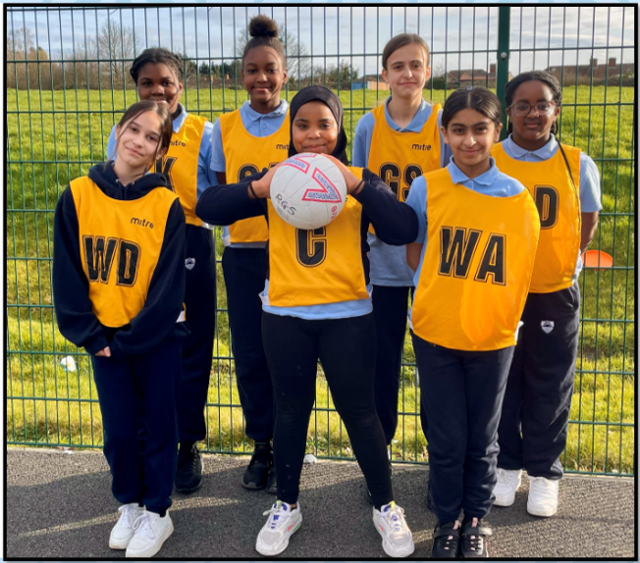
Student Support

Slide 11
Year 6 Explorer Day and Transition
Explorer 24th and 25th June
Induction meetings with SLT and Pastoral Team
3rd September first day at RGS, year 7 only

Slide 12
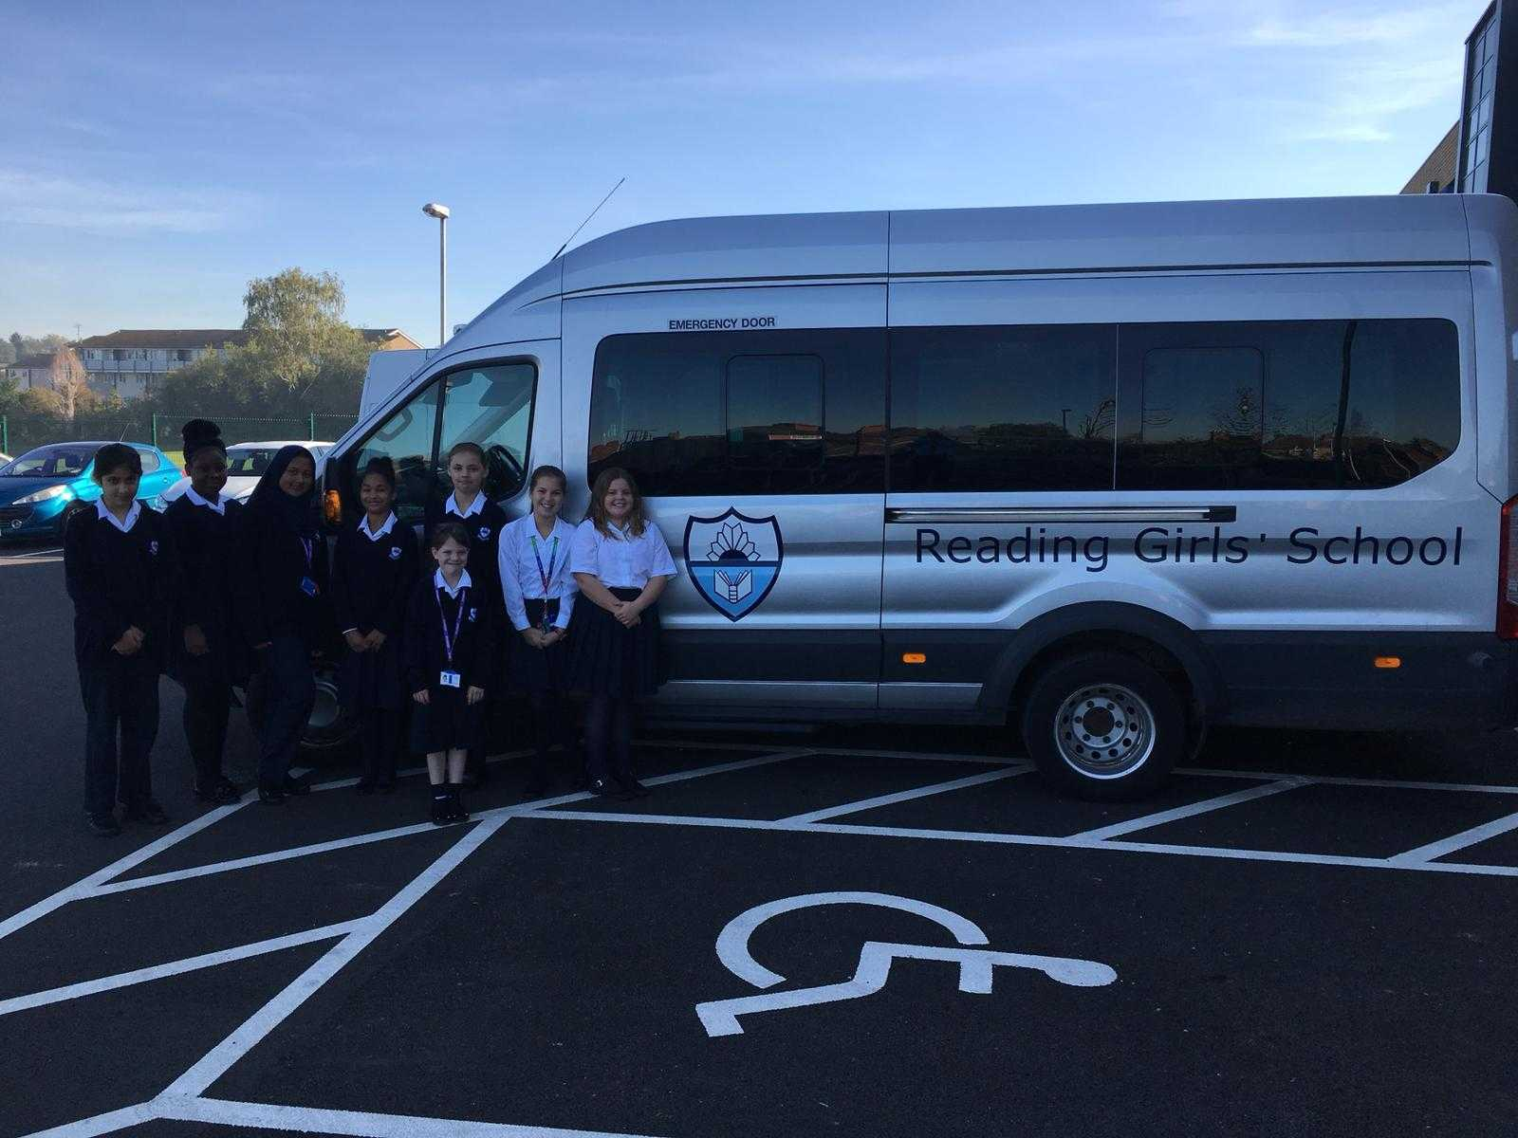
Expression of interest opens tonight and closes on 15th April.
School Buses
Direct service
Reading West (Tilehurst)
Reading West (Bath Road)
Reading South-East (Cemetry Junction)
Reading North (Upper Caversham)
Reading North-East (Lower Caversham)
Reading Central (No 91 Oxford Road Reading Buses)

Slide 13
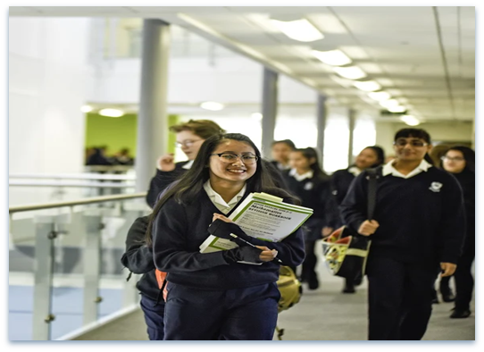
Come and see for yourself
Open evenings are informative… everyday is evidence!

